Slide 1


Sending Documents via OneSpan

Slide 2
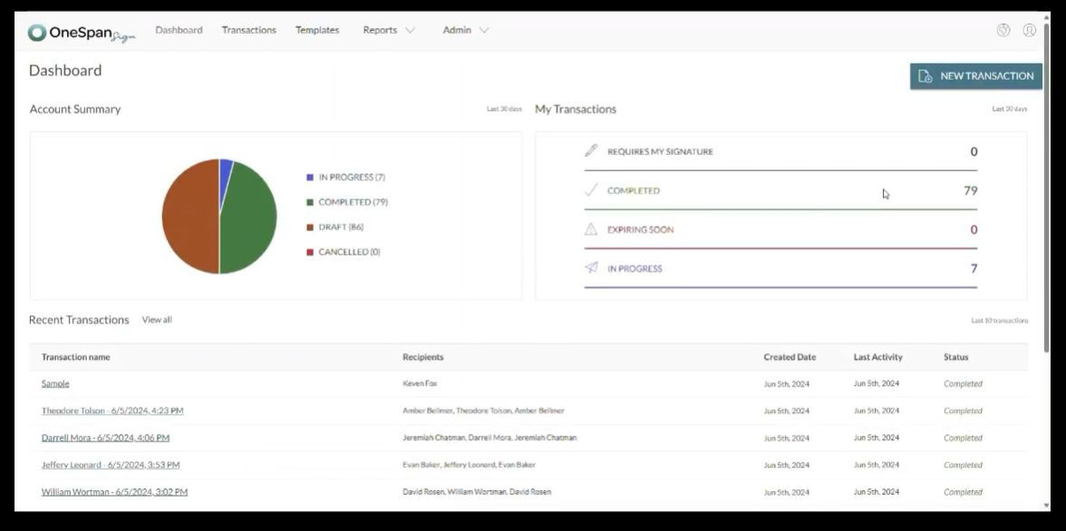
Sending Documents Via OneSpan
Once you log into the OneSpan website, you will see progress on this Dashboard page

Slide 3
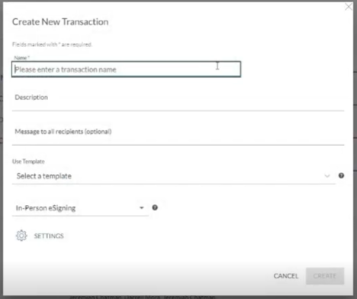
Name the transaction
Select Template if applicable
Select “eSign”
Click create
Once you see the Dashboard, you will click "New Transaction" in the top right corner of the screen.

Slide 4
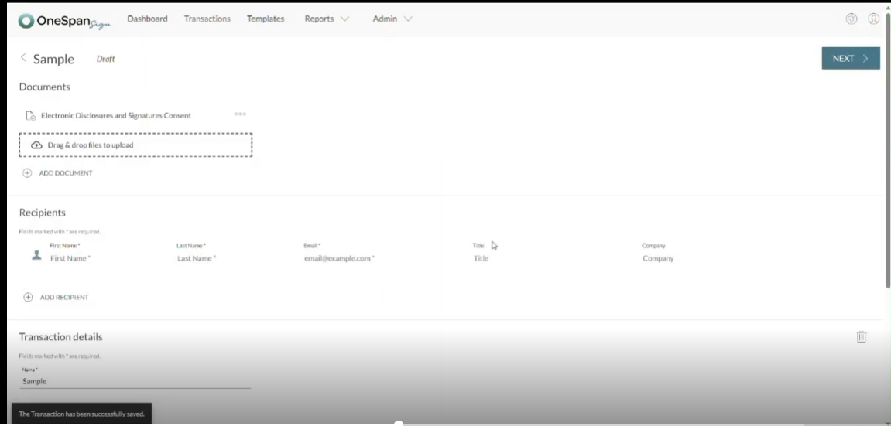
Sending Documents Via OneSpan
Either upload your document where it says “Add Document”
Or
You can drag and drop your document in the designated area

Slide 5
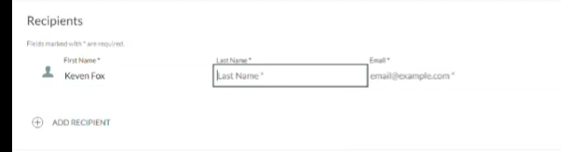
Sending Documents Via OneSpan
Enter the clients name and the email address you are sending the document to.
If two clients, repeat steps after clicking “Add Recipient”

Slide 6
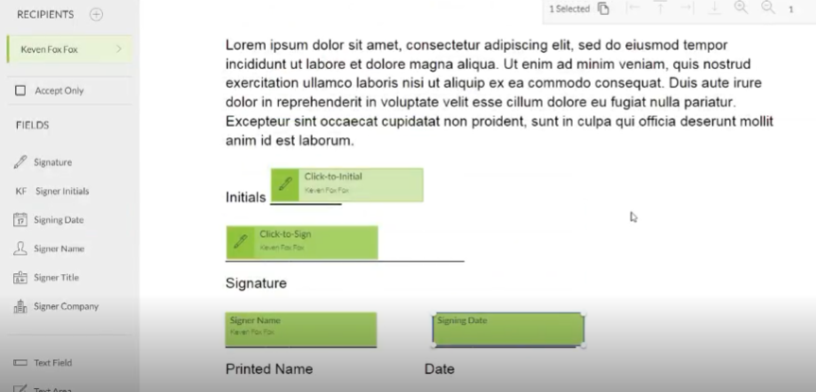
Sending Documents Via OneSpan
From the left side of the page select what is needed and drag it to the correct spot
Signature
Initials
Date

Slide 7
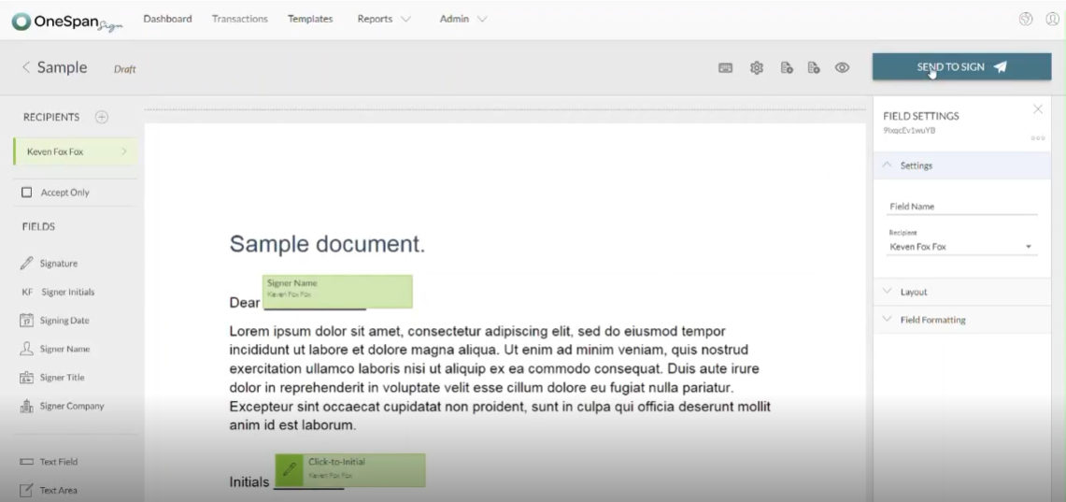
Sending Documents Via OneSpan
Once you have all your fields completed, click “Send to Sign” at the top right of the page

Slide 8
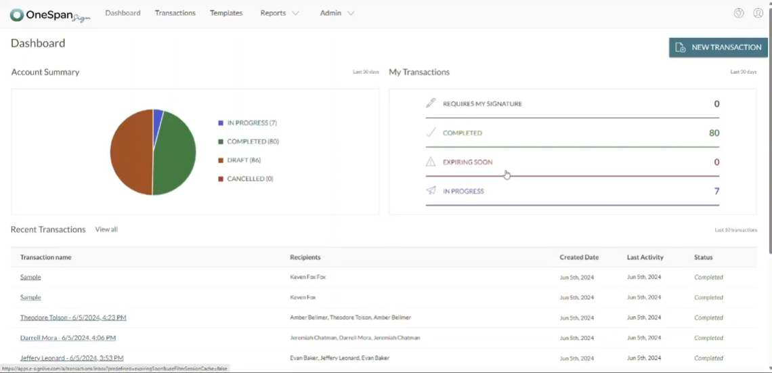
Once you click “Send to Sign” you will be automatically routed back to the dashboard. You will see your sent document at the bottom under “Recent Transactions.” You will also be able to see the status of the document and when it is completed.

